Slide 1

Influencing Factors To The Adoption Of Cloud Computing In Sri Lanka
B.Sc. Special Honours Degree In Information Technology
Field Specialization : Information System
Progress Review Presentation

Slide 2

Research ID - IS-12 005
Researcher
A.G.L.N.Silva - IT 09 2053 76
21-05-2012

Slide 3
Presentation Outline
Introduction
Research Problem
Objective Of The Research
Literature Review
Factor Framework
Factors Influencing The Adoption Of Cloud Computing (Organizational Factors)
Factors Influencing The Adoption Of Cloud Computing (Technological Factors)
Research Methodology
Hypothesis Assumptions
Future Plan For Major Milestones Up To Progress Review II
Issues For Continuity Of Research

Slide 4

Research Problem
The organizations in developing countries like Sri Lanka are lacking in responding to the adoption of cloud computing.
The reason for this problem is that the Sri Lankan organization are not aware of the influencing factors for the adoption of cloud computing

Slide 5
Objective of the Research
The Research Question
What are the Influencing Factors to the adoption of Cloud Computing in Sri Lanka?
Main Objective
To investigate the Influencing Factors for adoption of Cloud Computing in Sri Lanka
The Influencing Factors to the adoption of Cloud Computing will be identified in three perspective.
Technological Factors
Organizational Factors
Environmental Factors.
A.G.L.N.Silva

Slide 6
Sub Objectives
Sub Objective 1
To identify the Technological Factors influence to the adoption of cloud computing in Sri Lanka
Sub Objective 2
To identify the Organizational Factors influence to the adoption of cloud computing in Sri Lanka
Sub Objective 3
To identify the Environmental Factors influence to the adoption of cloud computing in Sri Lanka
Sub Objective 4
Developing a Factor Framework for the influencing factors for the adoption of cloud computing

Slide 7
Progress on Reviewing Previous Researches
Literature Review
Identification of Organizational Factors influencing the adoption of Cloud Computing
Identification of Technological Factors influencing the adoption of Cloud Computing
Identification of Variables to measure the factors influencing the adoption of Cloud Computing
Identification of Tools to measure the factors influencing the adoption of Cloud Computing
A.G.L.N.Silva

Slide 8
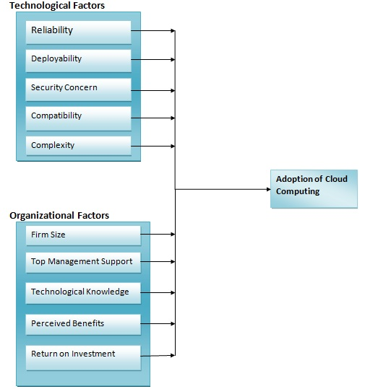
Conceptual Model

Slide 9
Factors Influencing The Adoption of Cloud Computing (organizational Factors)
Influencing Factors | Variables | Measurements
Firm Size/Nature of the firm | 1)Firm Size 2)Industry the firm operates | Number of Employees Technology, telecommunication education, retail, health, manufacturing, financial, government, legal, professional & other[16]
Top Management Support | Decision Making 2) Resource Allocation 3) Involvement and motivation | Number of Meetings Arranged Number of meetings attended Number of meetings cancelled/postponed[2] Number of human resource allocated for the project Amount of monitory value reserved for the project[2] Number of training programs provided Percentage of financial rewards provided for employee participation Performance evaluation[2]

Slide 10
Factors Influencing The Adoption of Cloud Computing (organizational Factors) cont…….
Influencing Factors | Variables | Measurements
Technological Knowledge of employees | Educational level required 2) Level of ICT usage (Low, medium, high) 3) Awareness on new technologies & past experiences in adopting technologies | Percentage of employees with the qualification G.C.E. A/L Percentage of employees with the qualification of diploma Percentage of employees with the qualification degree or above Percentage of employees with the qualification degree, professional, or technical Percentage of employees using office package (low) Percentage of employees using office package/ Internet/ email/Database systems(Medium) Percentage of employees using office package /internet/email and software packages(High)[16] Percentage of employees aware of new technologies Percentage of employees aware of cloud services Percentage of employees struggle with past technological experience & need changes Percentage of employees aware of risk in new technology adoption[16]

Slide 11
Factors Influencing The Adoption of Cloud Computing (organizational Factors) cont
Influencing Factors | Variables | Measurements
Return on Investment | 1) Revenue 2) Expenditure | Financial gain for the legacy system (Already Adopted firms) Financial gain for adopting cloud service (Already Adopted firms) Financial gain for the existing system(deciding to adopt cloud services and non adopted firms) Assumed amount of financial gain on adopting Cloud services(deciding to adopt cloud services and non adopted firms) Comparison of Total financial gain[15] Investment for the legacy system (Already Adopted firms) Investment for adopting cloud service (Already Adopted firms) Investment for the existing system(deciding to adopt cloud services and non adopted firms) Assumed amount to invest on Cloud services(deciding to adopt cloud services and non adopted firms) Comparison of Total expenditure[15]
Notes:
i

Slide 12
Factors Influencing The Adoption of Cloud Computing (organizational Factors) cont..
Influencing Factors | Variables | Measurements
Perceived benefits | 1)Ease of use 2)Usefulness 3)Profit | Percentage of benefits by using cloud computing (Already Adopted firms) Percentage of benefits from the existing technology (deciding to adopt cloud services and non adopted firms)[11] Percentage of expected benefits gained by using cloud computing (Already Adopted firms) Percentage of expected benefits from the existing technology(deciding to adopt cloud services and non adopted firms)[11] Return on Investment before adopting cloud service (Already Adopted firms) Return on Investment after adopting cloud service (Already Adopted firms) Comparison of Return on Investment[15]

Slide 13
Factors Influencing The Adoption of Cloud Computing (Technological Factors)
Influencing Factors | Variables | Measurements
compatibility | Usability Satisfaction of the end users (Employees) Work Efficiency | The percentage of cloud services which are focused on firms core business functions Number of services which are suitable for trailability before decision making(decided to adopt) Percentage of service that fits with the task that employees like to do[13] Percentage of employee turnover (already adopted) Percentage of employee turnover(decided to adopt & not adopted) Percentage of employee participation in decision making of cloud service adoption Percentage of employees understood the benefits of cloud computing[1] Percentage of continuous improvement after the adoption of cloud services(already adopted)[6] Percentage of failures in work (already adopted)

Slide 14
Factors Influencing The Adoption of Cloud Computing (Technological Factors) cont……
Influencing Factors | Variables | Measurements
Deployability | IT infrastructures Skills of the employees regarding the level of ICT usage (Low, medium, high) | Percentage of financial investment for IT infrastructure to adopt cloud services Percentage of financial investment for current IT infrastructures used in firms for IT related operations[15] Percentage of employees using office package (low) Percentage of employees using office package/ Internet/ email/Database systems(Medium) Percentage of employees using office package /internet/email and software packages (High)[16]
Reliability | Availability Integrity Confidentiality Consistency | Access time of cloud services at any instants Percentage of confidence on authorization Trust worthiness on service provider.[4]

Slide 15
Factors Influencing The Adoption of Cloud Computing (Technological Factors) cont……
Influencing Factors | Variables | Measurements
Complexity | comprehensibility | Percentage of employees comfortable with cloud services Percentage of employees understood the benefits of cloud services Percentage of employees do not prefer cloud service as a solution for their IT related operations[16]
Security | Trust Amount of system failure | Percentage of firms study the History cloud computing service providers Percentage of top management involves the cloud computing service providers in decision making process. Percentage of top management confident in data security[4] Time that internet service available within the firm Percentage of virus threats caused from internet usage[4] A.G.L.N.Silva

Slide 16
Progress on Methodology
Research Methodology (So far the team progressed)
Identification of research problem from literature review
According to the research problem the main objective and sub objectives were specified
Identified the organizational, and technological factors from previous researches to develop conceptual model
Research Methodology (Future progress)
These factors which helped to develop a conceptual model will be tested quantitatively to prove that these are the factors which will influence the adoption of cloud computing
A.G.L.N.Silva

Slide 17
H1: Organizational Factors influences the adoption of Cloud Computing in Sri Lanka
H1 a: The Top Management Support of the firm positively influences the adoption of Cloud Computing.
H1 b: The Size of the firm positively influences adoption of Cloud Computing.
H1 c: The Technological Knowledge of an organization positively influences adoption of Cloud Computing.
H1 d: The Perceived Benefits by the organization, positively influences adoption of cloud computing
H1 e: The Return on Investment of an organization positively influences adoption of cloud computing

Slide 18
H2: Technological factors influences the adoption of cloud computing in Sri Lanka
H2 a: The perceived Compatibility of the cloud service positively influences adoption of Cloud Computing.
H2 b: The perceived Security of the cloud service positively influences adoption of Cloud Computing.
H2 c: The perceived Reliability of the cloud service positively influences adoption of Cloud Computing.
H2 d: The perceived Deployability of the cloud service positively influences adoption of Cloud Computing.
H2 e: The perceived Complexity of the cloud service positively influences adoption of Cloud Computing.

Slide 19
Future Plan For Major Milestones Up To Progress Review II
Activity | Progress | Time allocation
Data Collection | Preparing Questionnaires | 28-05-2012 to 04-06-2012
Data Collection | Preparation for formal and informal interviews | 28-05-2012 to 04-06-2012
Data Collection | Visiting firms | 06-06-2012 to 20 -07-2012
Data Analysis | Analyzing the collected data | 06-06-2012 to 25-07 2012
Preparing Document | Documenting the collected data and the analysis | 06-06-2012 to 25-07 2012
Presentation for progress review ii | Presenting the analysis | 30-07-2012

Slide 20
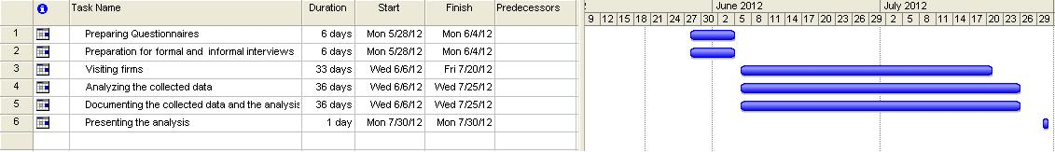
Time Line

Slide 21
Issues for Continuity of Research
Due to the time constrain analysing the environmental factors which influences the adoption of cloud computing in Sri Lanka is difficult.
Therefore the Environmental factors will be analysed with organizational and technological factors in designed conceptual model.
There are very less amount of organizations in Sri Lanka have adopted cloud computing. It is a barrier for the continuity of research.
The team will be collecting and analysing data through snow ball technique.

Slide 22
Conclusion
Identified the organizational, and technological factors from previous researches to develop conceptual model
Identification of variables to measure the factors influencing the adoption of Cloud Computing
Identification of tools to measure the factors influencing the adoption of Cloud Computing
Focusing on future progress

Slide 23
References
[1] Timothy Rollins. Using the Innovation Adoption Diffusion Model to Target Educational Programming, pp 46-53, 1993.
[2] Light, Ben, Papazafeiropoulou. Reasons Behind ERP Package Adoption: A Diffusion Of Innovations Perspective.
[3 ]Kunihiko Higa, Olivia R. Liu Sheng, Paul Jen-Hwa Hu, Grace Au. Organizational Adoption and Diffusion of Technological Innovation:A Comparative Case Study on Telemedicine in Hong Kong 1997.
[4] Amit Sangroya, Saurabh Kumar, Jaideep Dhok, Vasudeva Varma. Towards Analyzing Data Security Risks in Cloud Computing Environments, pp 255-265, 2010.
[5] Z. Kotulski, Z.Wąsik, B. Dorożko. Employee is also a customer. How to measure employees’satisfaction in an enterprise?
[6] Mahesha Kapurubandara. A Framework to E-Transform SMEs in Developing Countries, pp 2-24, 2009.
[7] Marianne S. Hornor. Diffusion of Innovation Theory, 1998.
[8] Nigel Bevan. Measuring usability as quality of use, vol 4, pp 1-20, 1995.

Slide 24
References cont..
[9] Vladimir Belenkovich. Reference Model of Cloud Computing public carrier’s view, 2010.
[10] Ali Khajeh-Hosseini, David Greenwood, James W. Smith, Ian Sommerville.
[11] The Cloud Adoption Toolkit: Supporting Cloud Adoption Decisions in the Enterprise, pp 1-20 2009.
[12] Inma Rodríguez-Ardura, Antoni Meseguer-Artola. Towards a longitudinal model of ecommerce:environmental, technological and organizational drivers of B2C adoption, vol 26,pp 1-20 , 2010.
[13] José Esteves, Joan Pastor, Josep Casanovas. Measuring Sustained Management Support in ERP Implementation Projects: A GQM Approach, pp 1-8.
[14] M.Saunders, P.Lewis, A.Thornhill.Research methods for business students, (5th edition).[online]vol.1, Available: http://www.pearsoned.co.uk/HigherEducation/Booksby/Saundersetal/ [May.,15,2012]
[15] http://iteconcorp.com/ROICalc.html
[16] Cloud computing Adoption Survey SMEs-1(Newcastle University United kingdom)

Slide 25

Thank you
Sri Lanka Institute Of Information Technology

